Slide 1

Paradigms of Software
CIDM 4390 and 6330
Spring 2021

Slide 2
Paradigm Overview
Martin Chapter 3

Slide 3
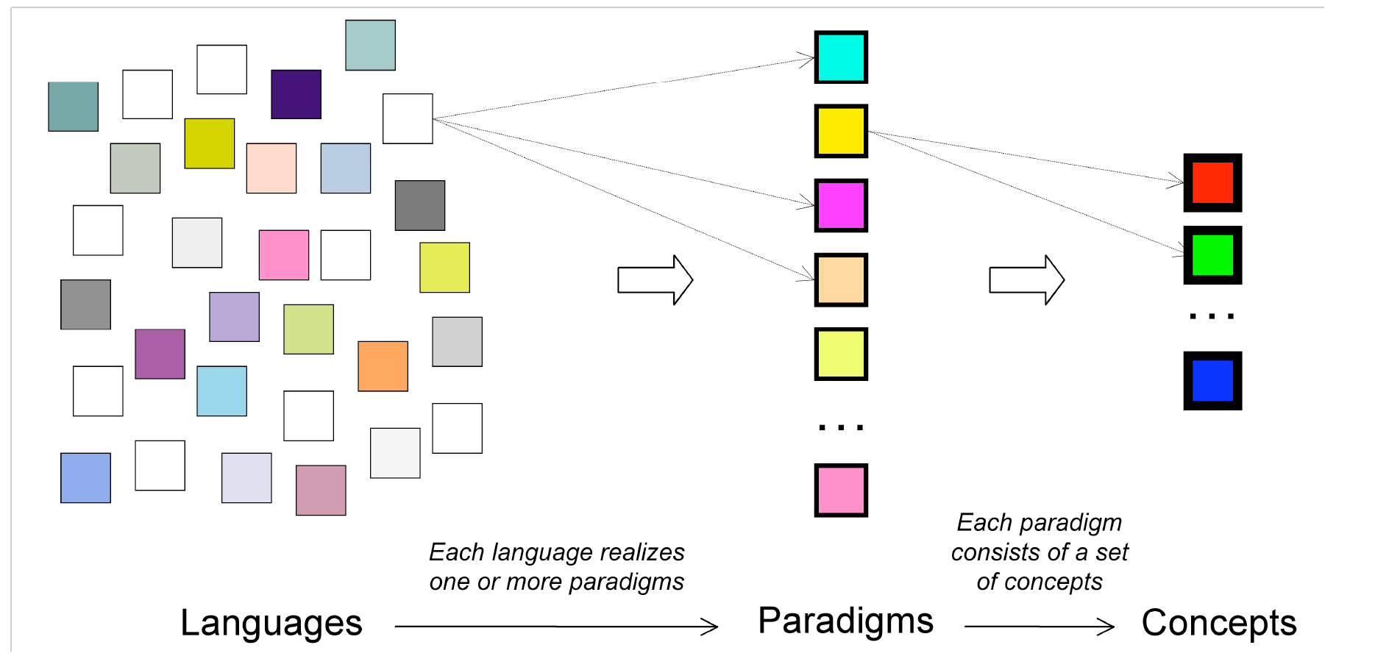
Paradigm?
Van Roy, 2009

Slide 4
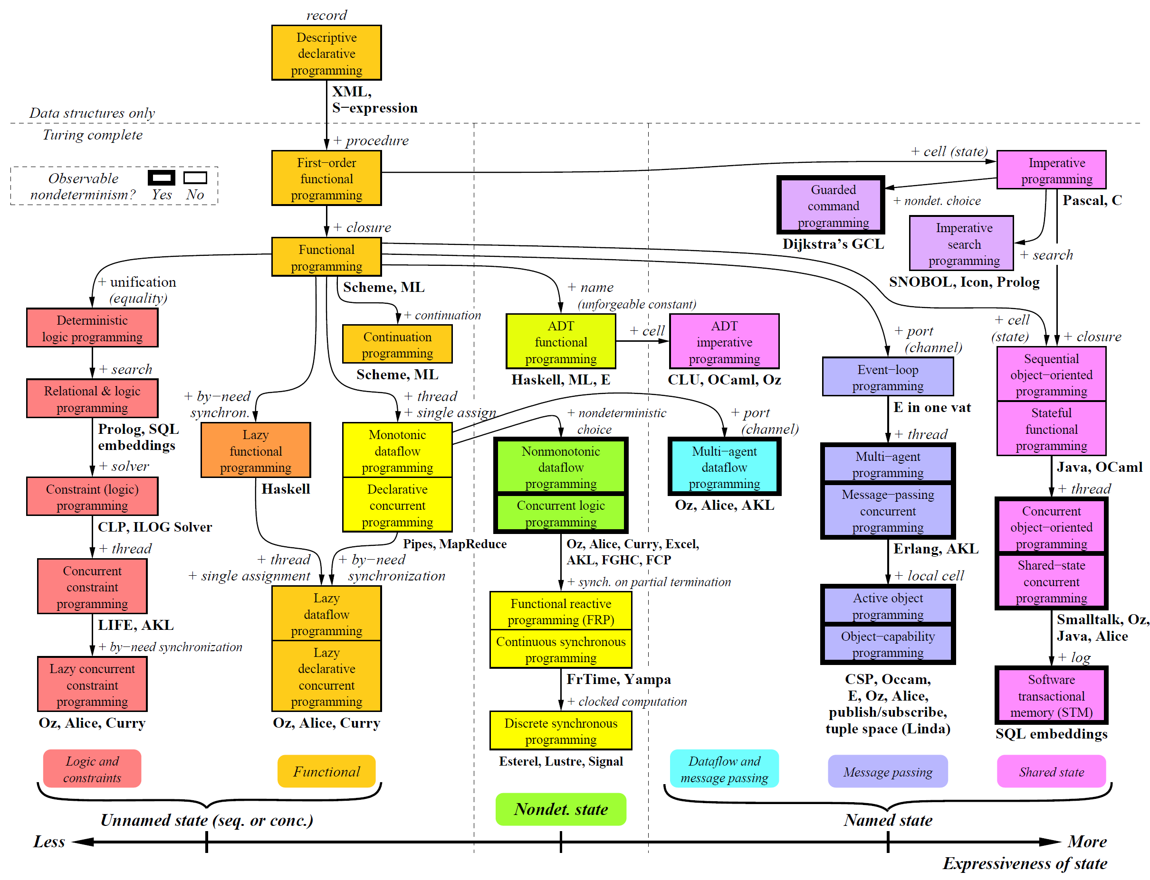
Example

Slide 5
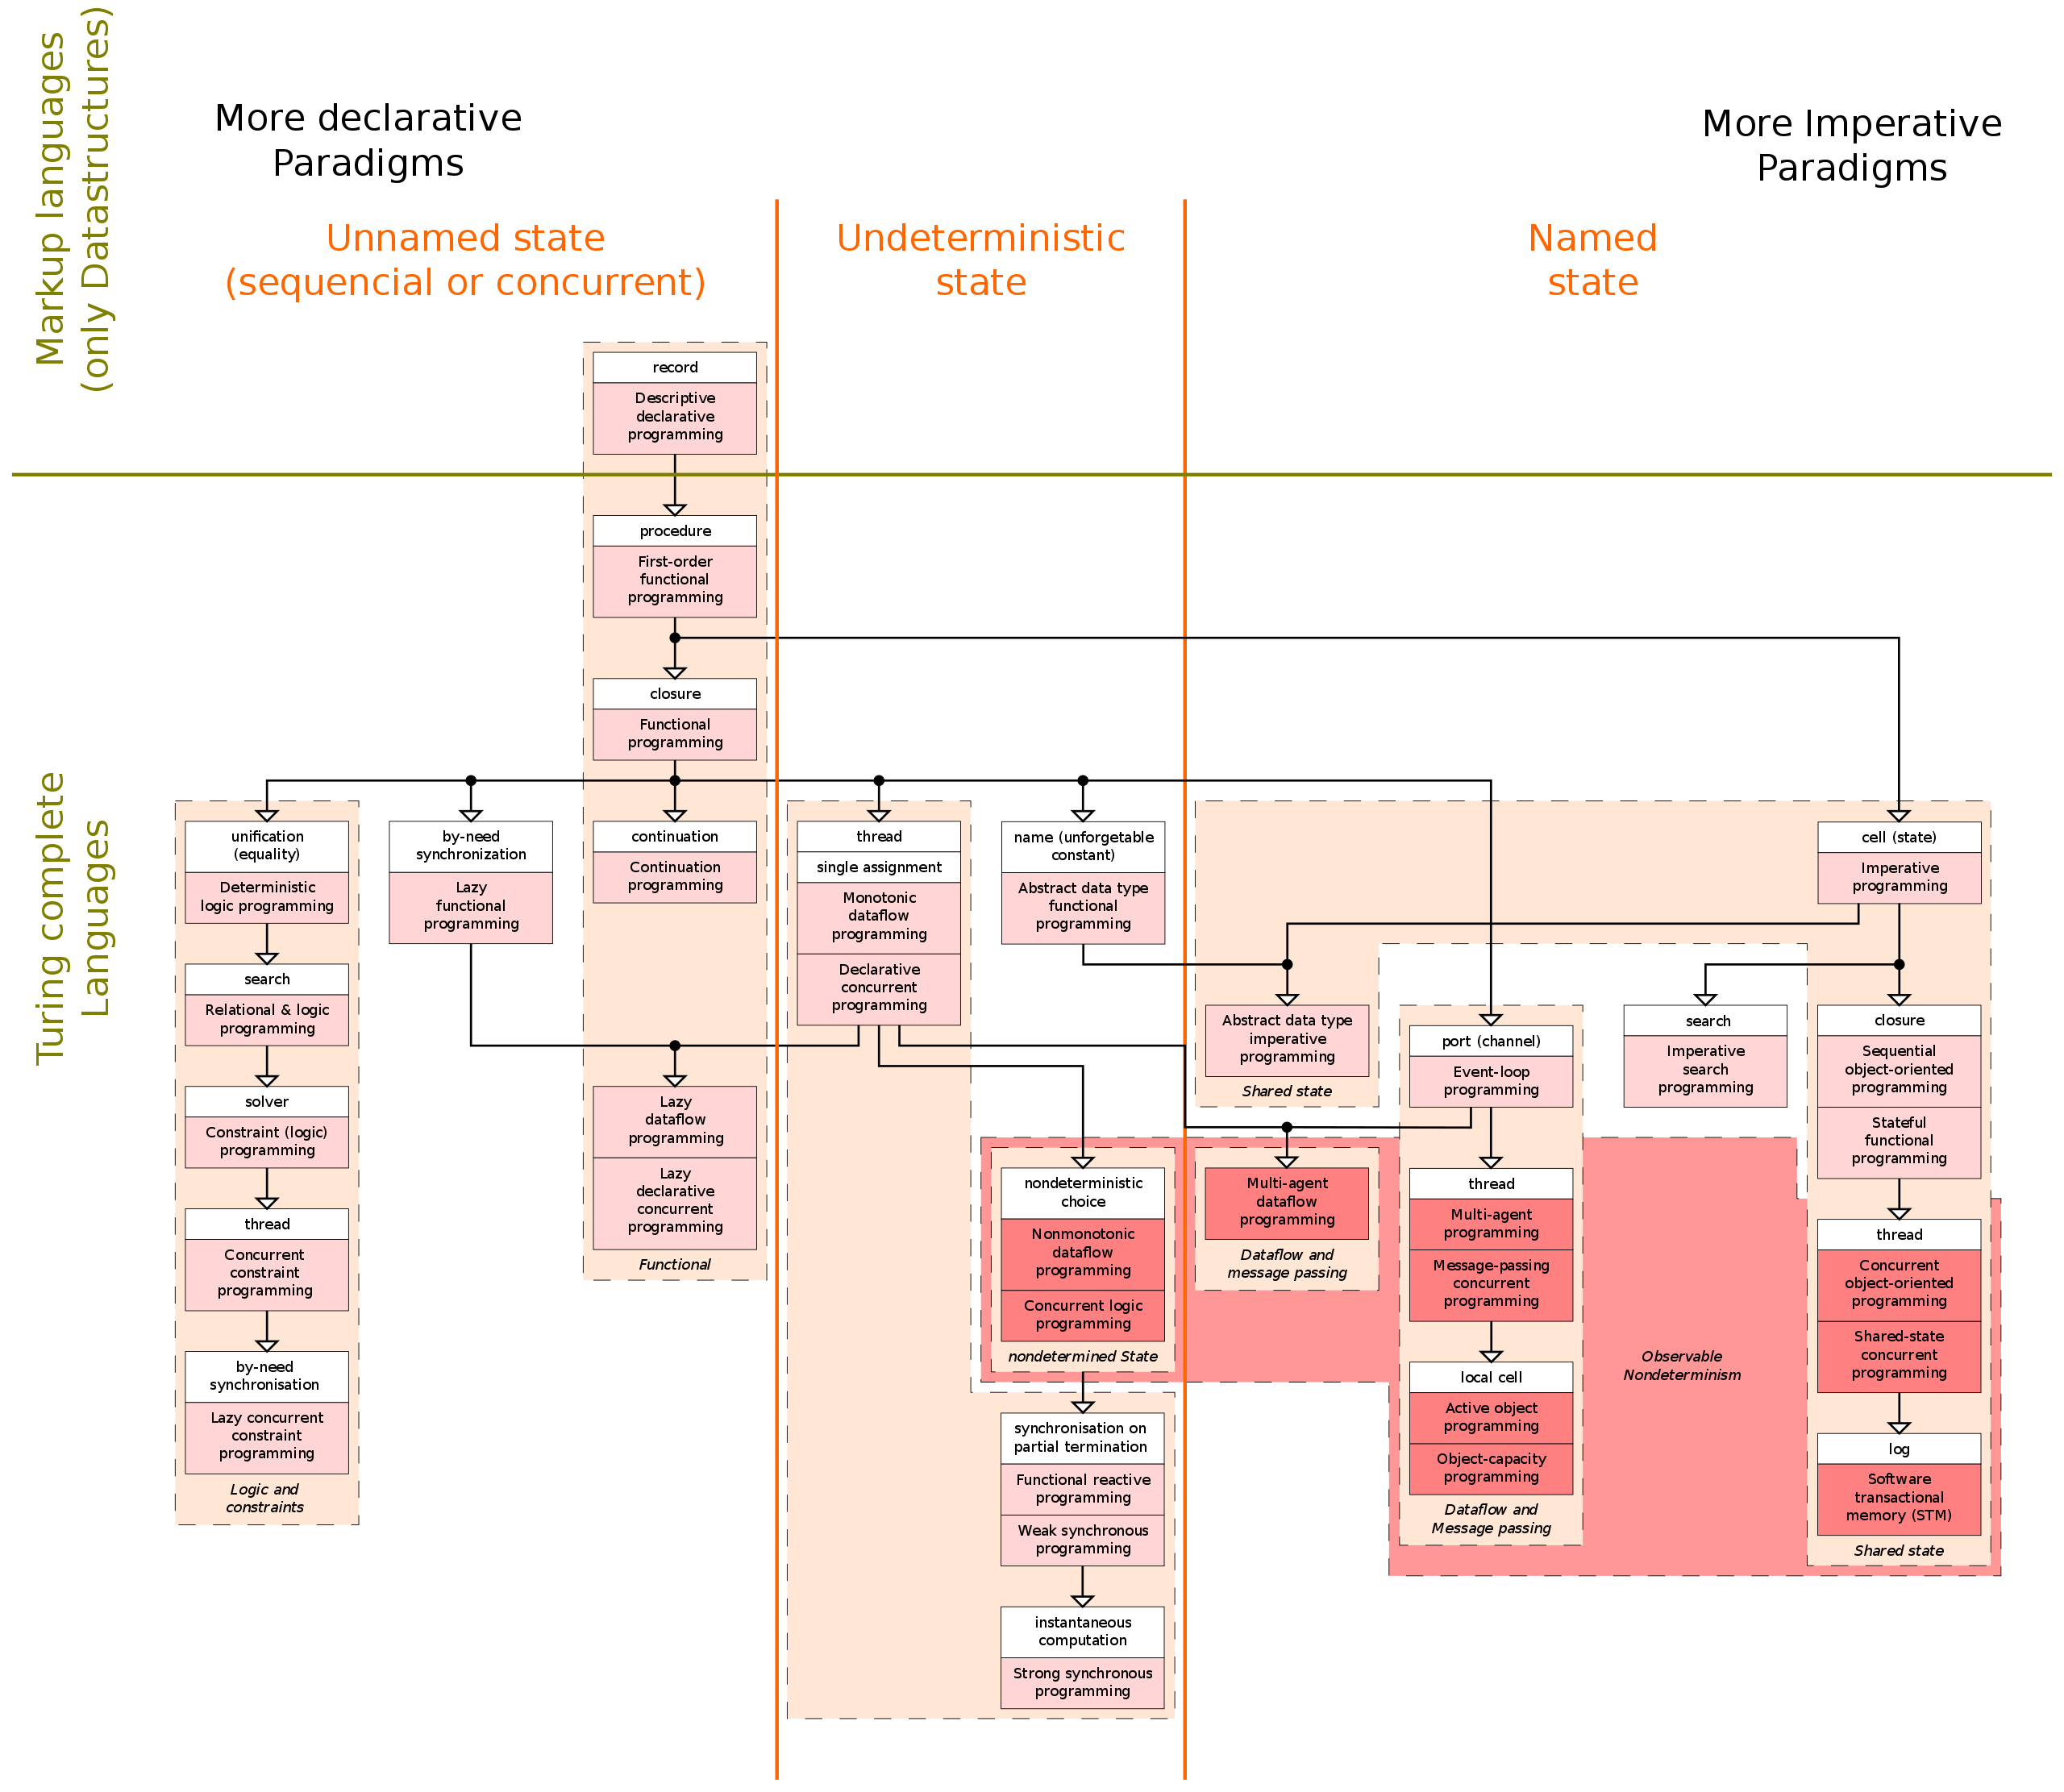

Slide 6
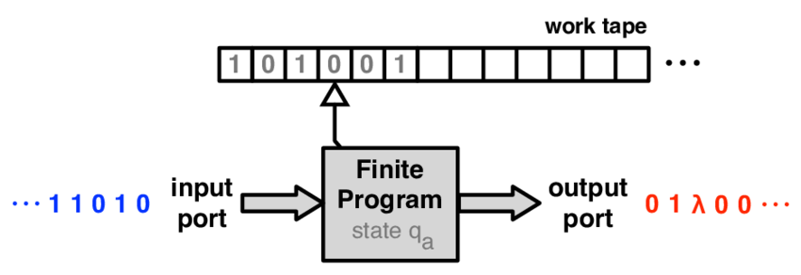
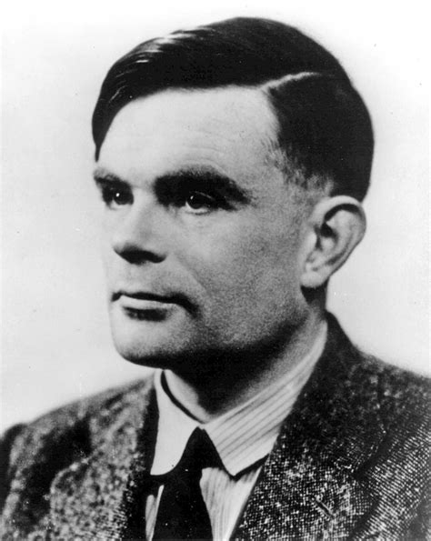
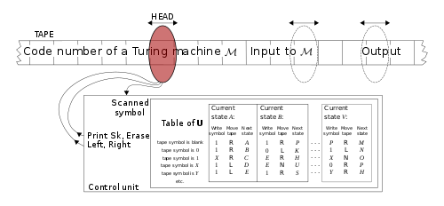
Turing Complete?
Alan Turing

Slide 7
Die Paradigmen
Structured – Algorithm and Business Logic
Imposition of discipline on direct transfer of program control
Principal Features: Control Structures
Object-Oriented - Architecture
Imposition of discipline on the indirect transfer of program control
Principal Features: Encapsulation, Inheritance, Polymorphism, and Inversion of Control
Functional – Data Management
Imposition of discipline upon variable assignment
Principal Features: Immutability

Slide 8
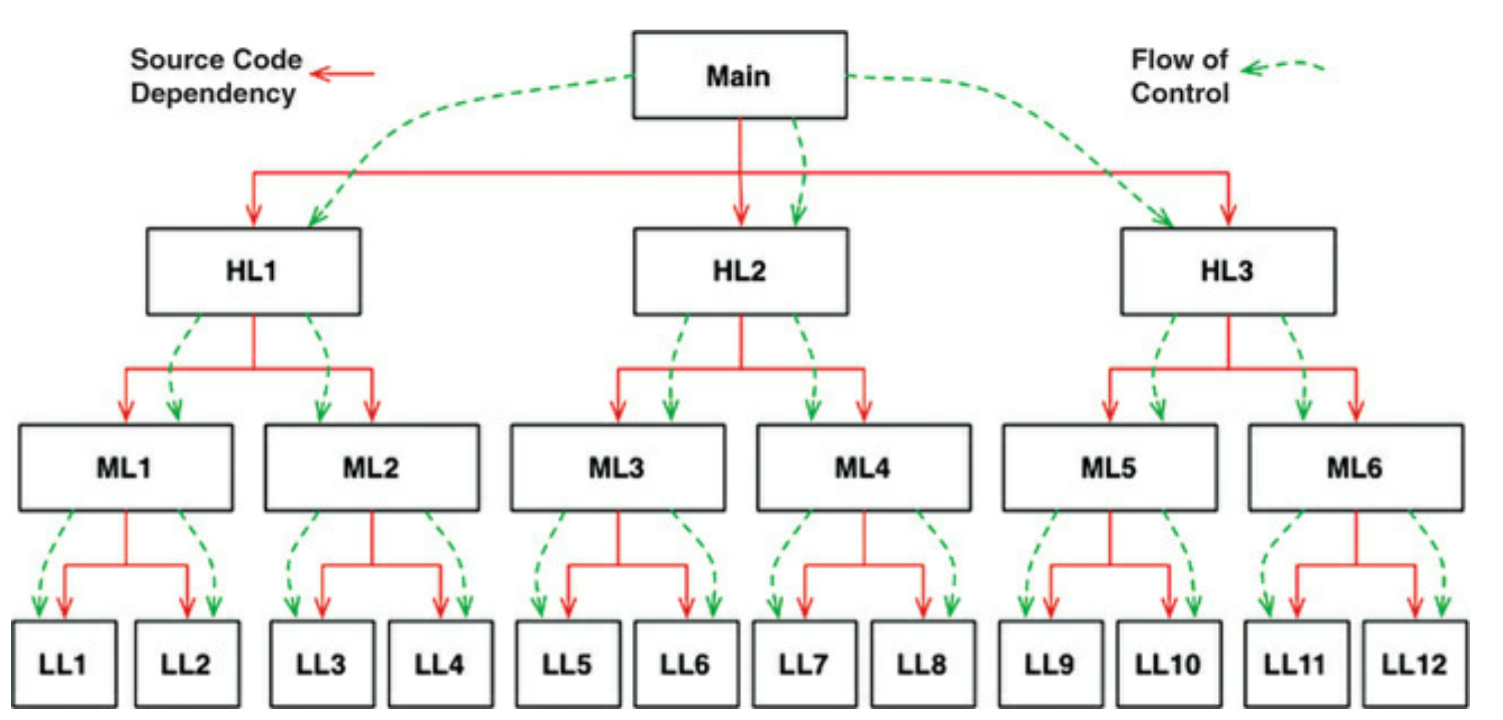
Elaborations: Dependency Inversion
“Know it all”

Slide 9
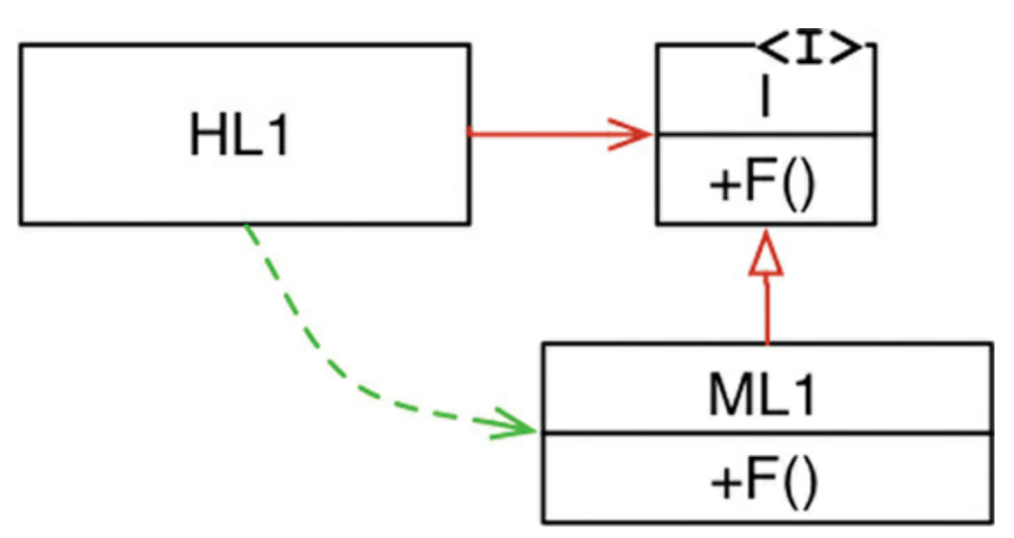
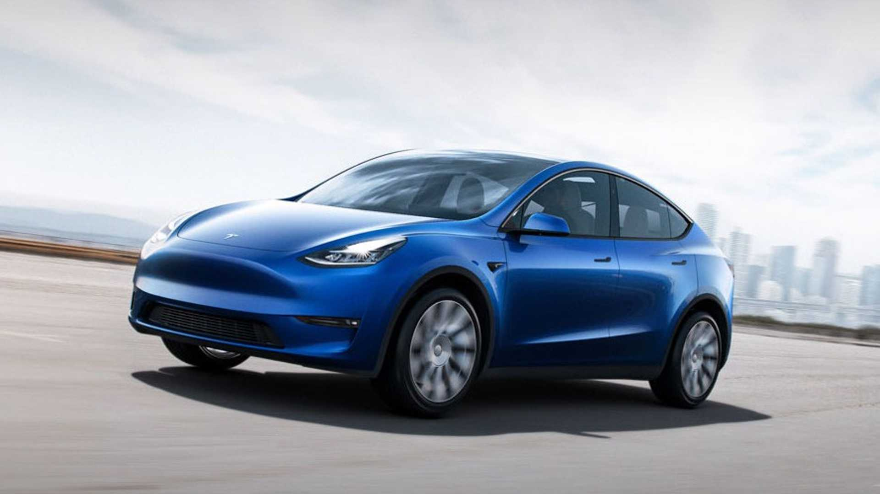
Dependency Injection
“My brain hurts”

Slide 10
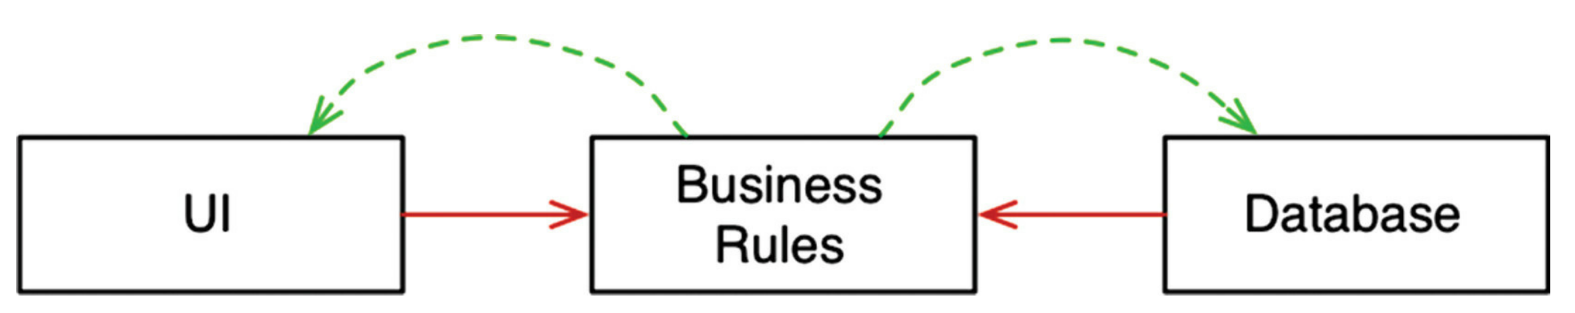
Pragmatic Architectural Example

Slide 11
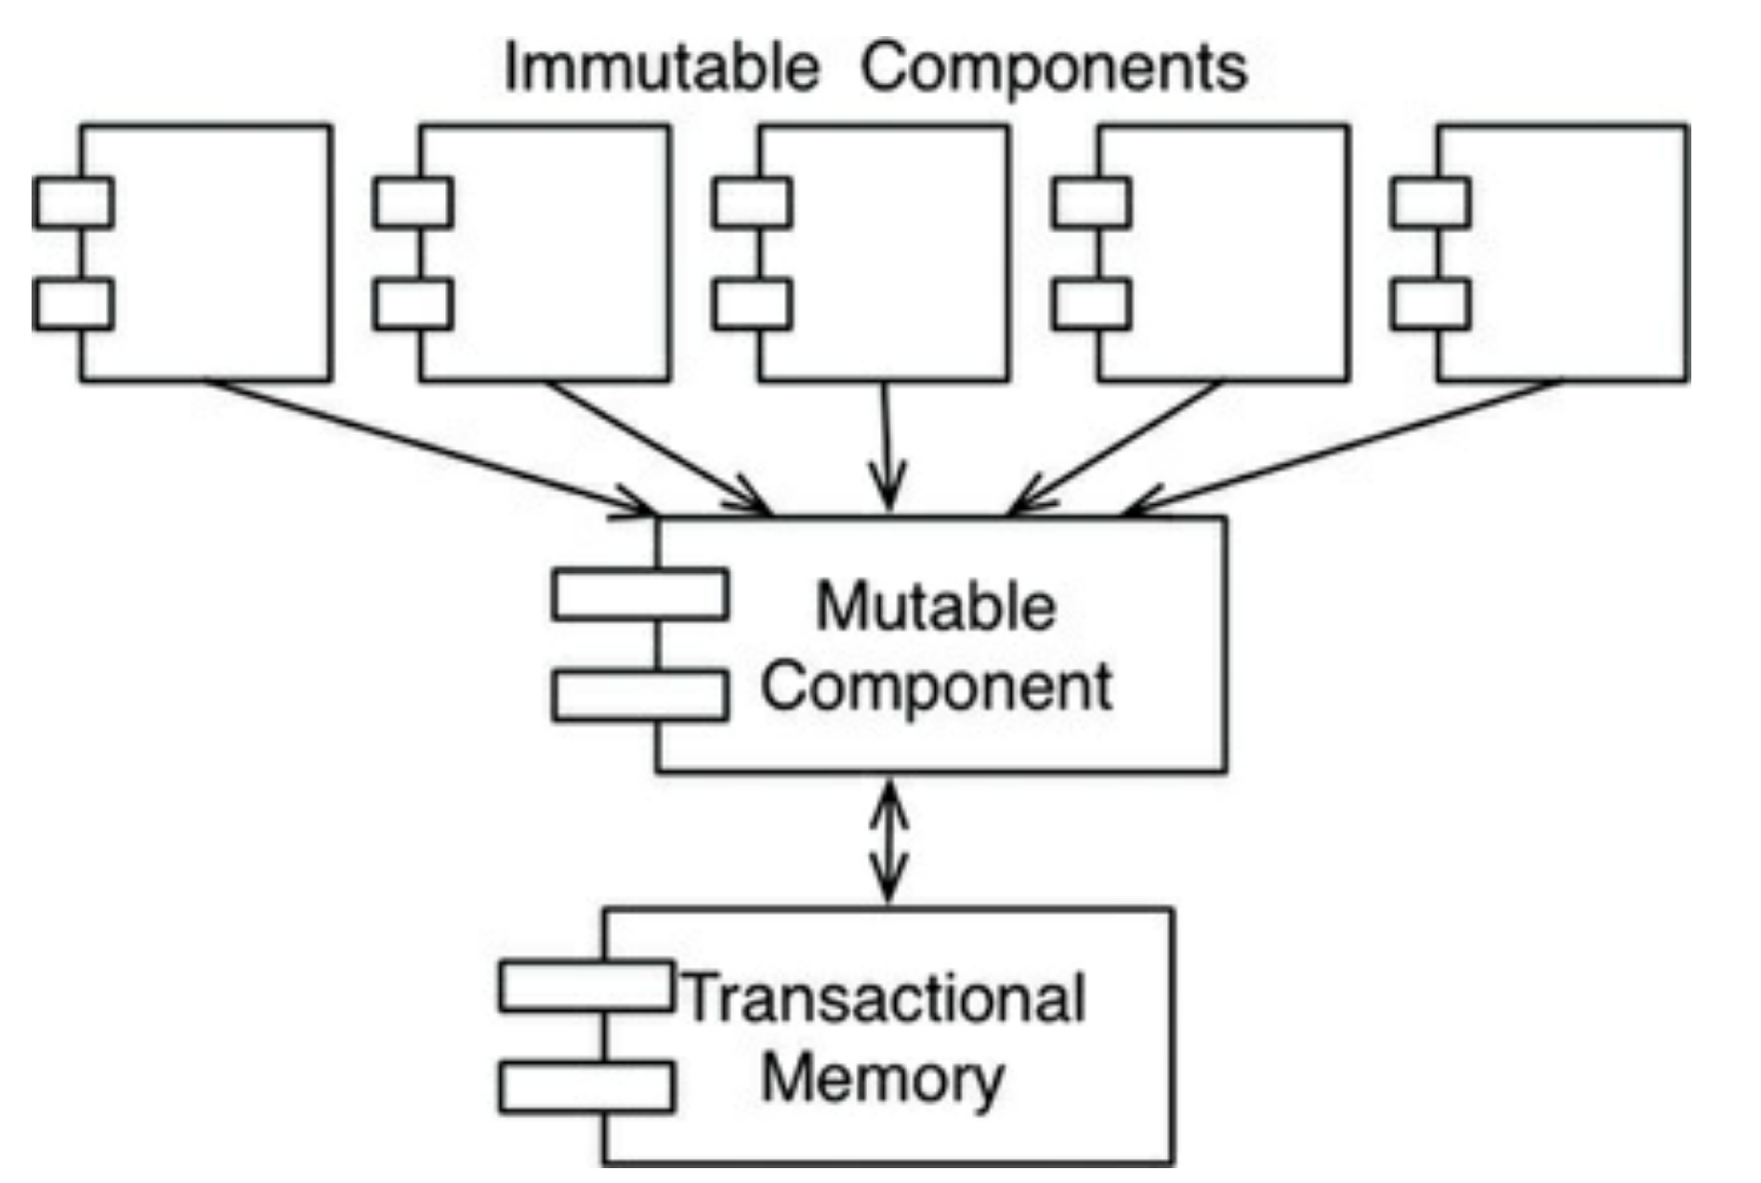
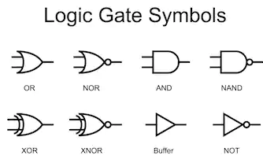
Elaboration: Mutability

Slide 12
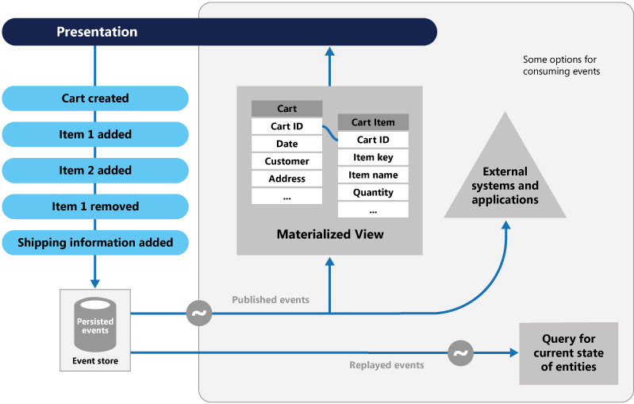
Pragmatic Example: Event Sourcing
Microsoft, 2021

Slide 13
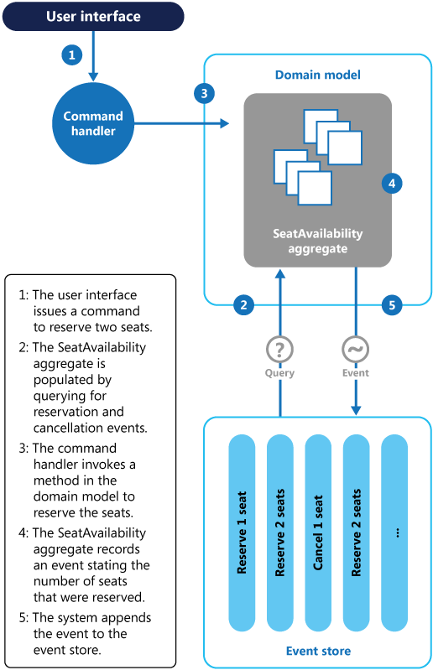
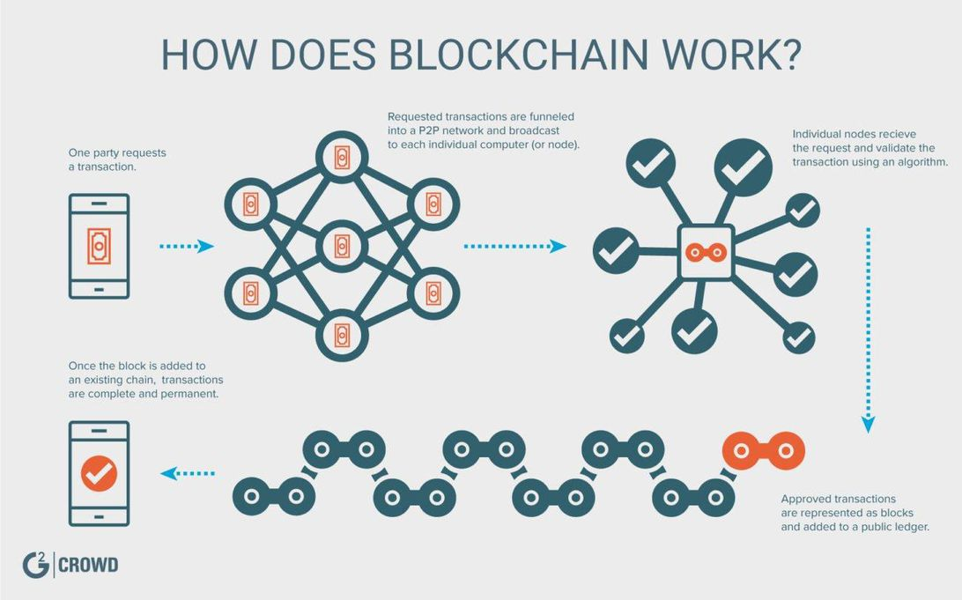
Event Sourcing and Repudiation
Microsoft, 2021

